Slide 1
Stock Volatility Prediction
Dingyu Sun
Jian Jian
Rishabh Upadhyay
Sharvil Turbadkar

Slide 2
Agenda
Project Overview
Approach
Reference Articles
Data Description
Time Series plot and scatterplot
Summary statistics
Model Selection

Slide 3
Project Overview
Our project goal is to predict the beta value by building several time-series models and comparing the prediction with the beta value we computed from the CAPM formula.
Beta measures the volatility of an individual stock in relation to the overall market. The beta of the individual stock measures the degree of its deviation from the market. A beta value larger than one represents the stock swings more than the market stock. If a stock's beta is less than one, it means that the stock has a lower movement than the market. In this project, we utilized different features to build the time series model and predict the beta value.
While computing the value of beta we will also be computing risk premium.
Risk Premium is usually applied to equities and companies as a measure of how much the potential investor needs to be compensated to take on the extra risk when compared to a risk-free investment, which is usually the US 10 year Treasury.

Slide 4
Approach
Download stock and Dow jones data from yahoo.com
Download risk free rate from Federal reserve bank of St Louis
Add trend and seasonal variables (4 seasons)to the dataset
Add dummy variables (two if three stocks are considered)
Compute true beta value by using actual CAPM formula
Forecast using time series modelling
Compute p-value for all predictors and using backward propagation remove attributes that have high p-values
Interpreting and summarizing the model

Slide 5
Reference Articles
https://www.wallstreetmojo.com/capm-beta-definition-formula-calculate-beta-in-excel/ -The following article discusses about the impact of myriad factors on the value of beta and which industries tend to have higher betas and which industries tend to have a lower beta .The value of beta depends upon the nature of the business (cyclic ) along with the financial debt the company owes
https://finvert.home.blog/2019/02/28/how-helpful-is-beta/- The following article discusses about the applications of beta and also dives deep into its limitations
https://www.investopedia.com/terms/m/marketriskpremium.asp- What is market risk premiums and its applications

Slide 6
Data Description
Document source of the data: In this project, we used a finance package called "quantmod" to download the finance data from the website. By entering the symbol of the stock and website name also the data period, we can download the data from that website. In this project, we set the start date as 2010 and the end date as 2020 and download the monthly data from Yahoo Finance.
The final dataset contains data from a ten-year window from 2010. It contains 291 rows and 12 columns.

Slide 7
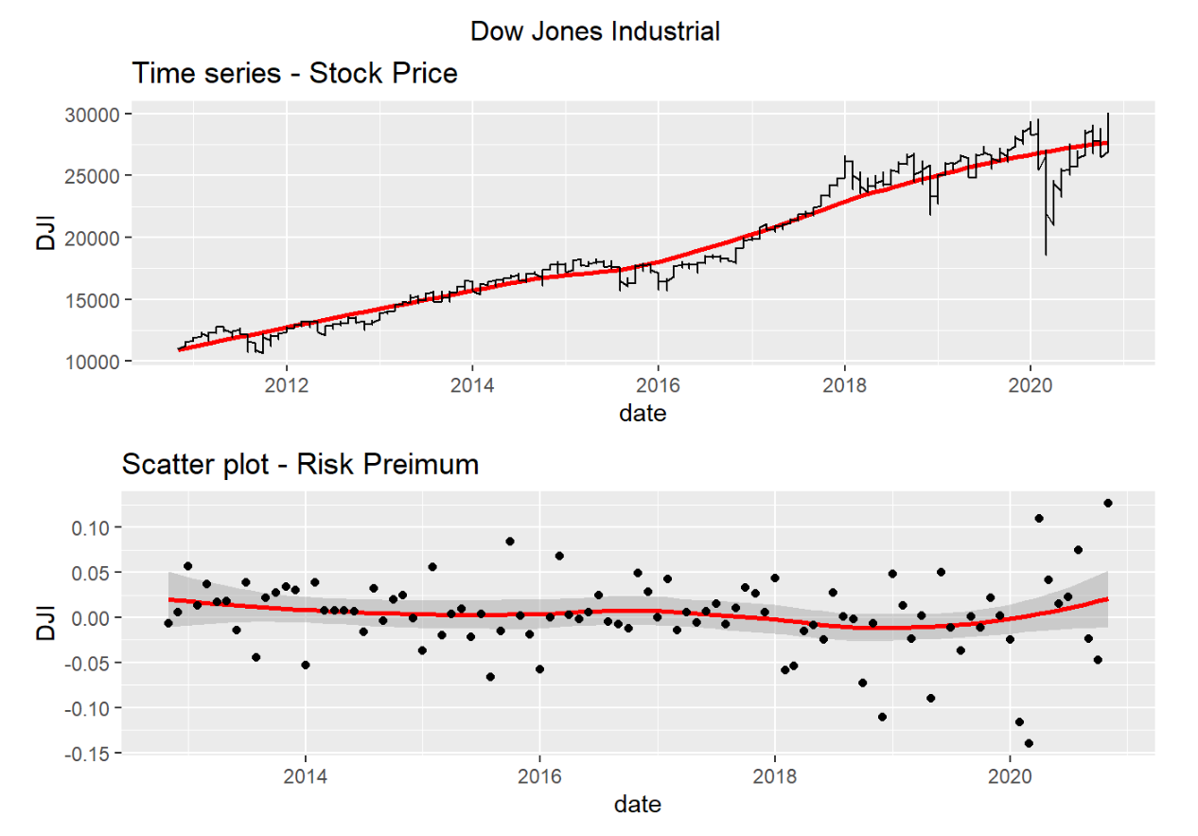
Dow Jones -Time Series plot and scatterplot
The time series plot shows a daily positive relationship to the market price of the Dow Jones Industrial. The relationship between the date and the risk premium seems flat.

Slide 8
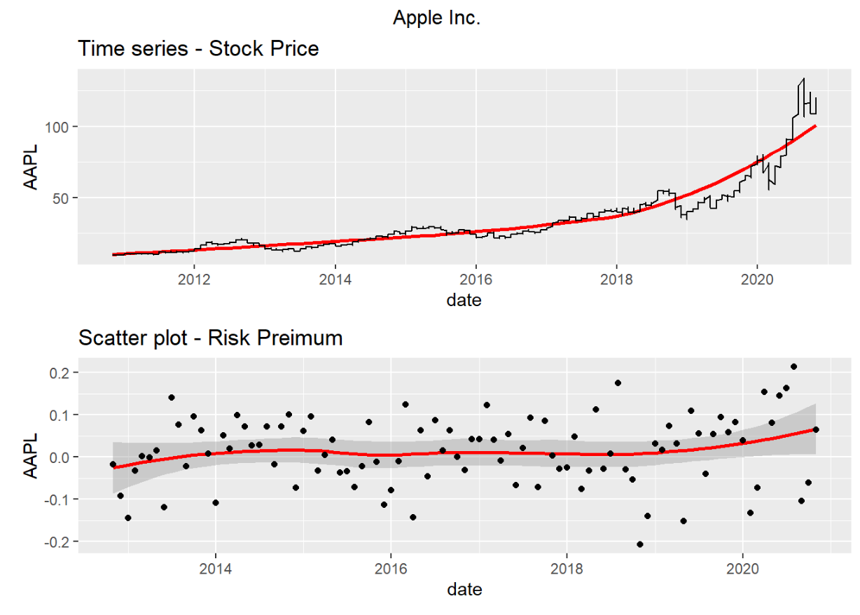
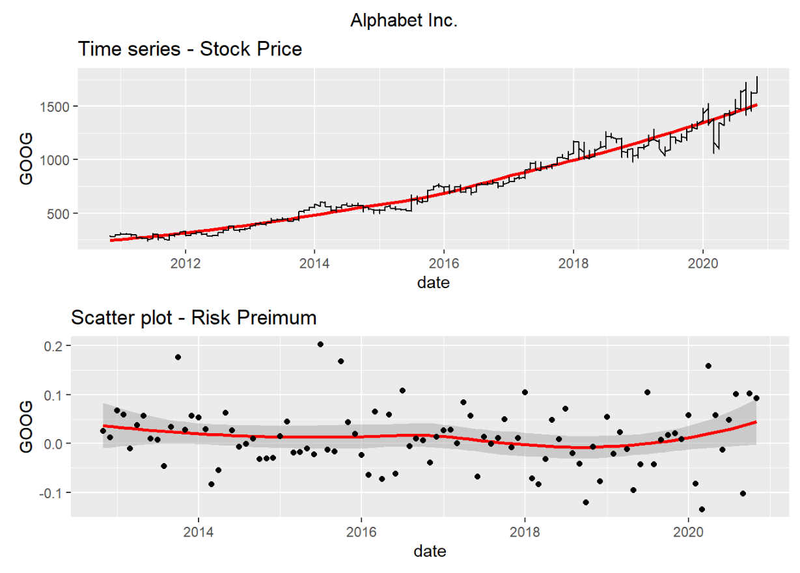
Time series and scatterplot of Apple and Alphabet
Compared with the Dow Jones Industrial plot, the time series plot of Apple Inc like a quadratic plot. With the date increasing, the stock price of Apple Inc increased at a fast speed. The scatter plot is pretty flat.
The time series plot shows that the date seemingly has a linear relationship with the stock price of Alphabet Inc, and the point spread of the scatter plot is more spread than the previous two plots.

Slide 9
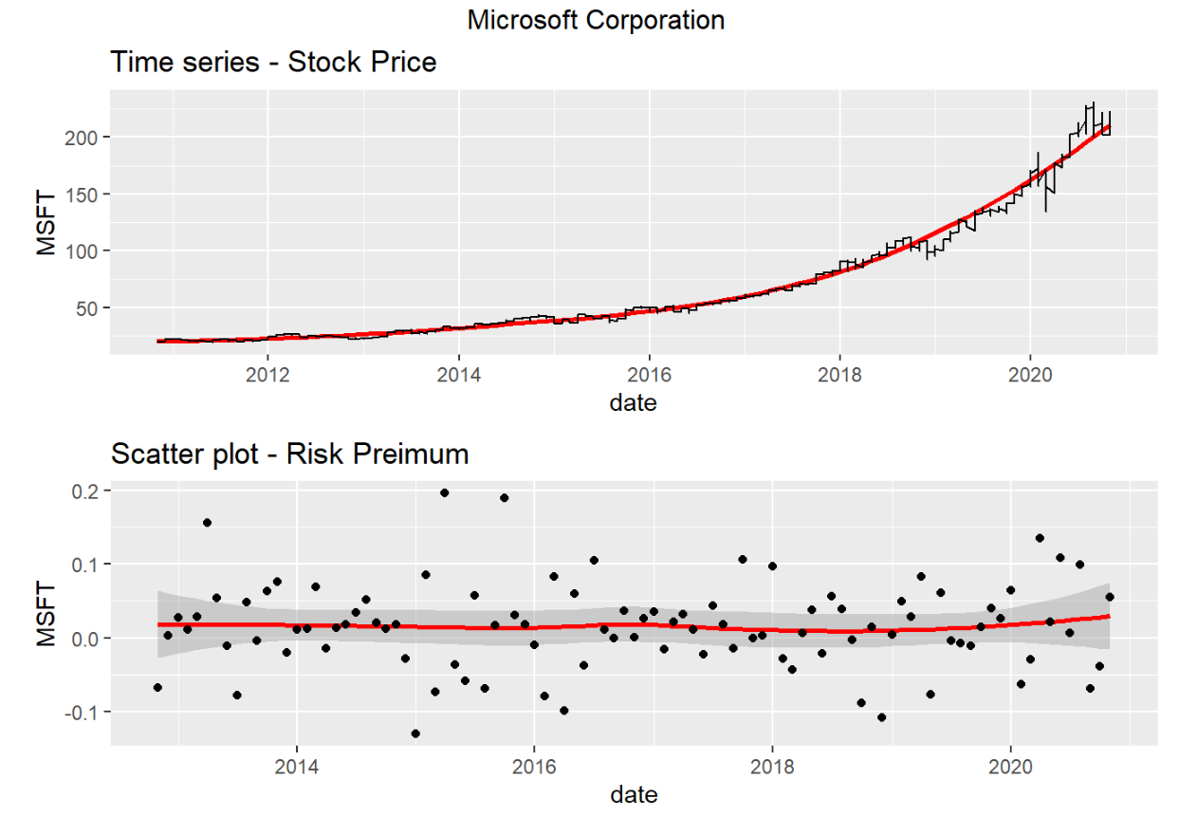
Time series and scatterplot of Microsoft
The trend of the time series plot is similar to Apple Inc, and the variation of the scatter plot is more spread out than the previous two stocks

Slide 10
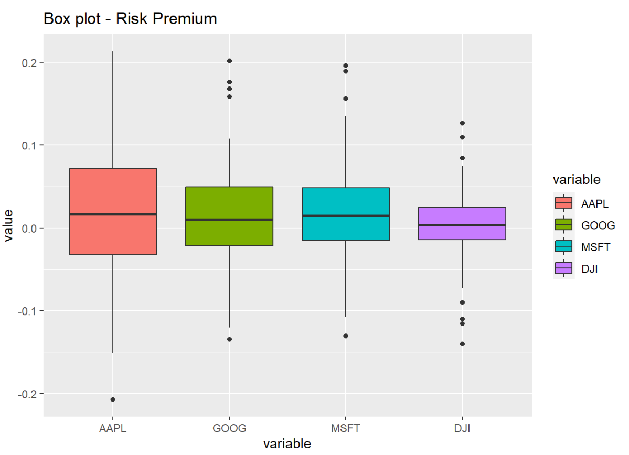
Summary Statistics-Boxplot distribution
Comparing with other companies, Apple Inc has the largest risk premium distribution, and Microsoft Corporation has the smallest risk premium distribution, which means Apple Inc might have the highest risk.

Slide 11
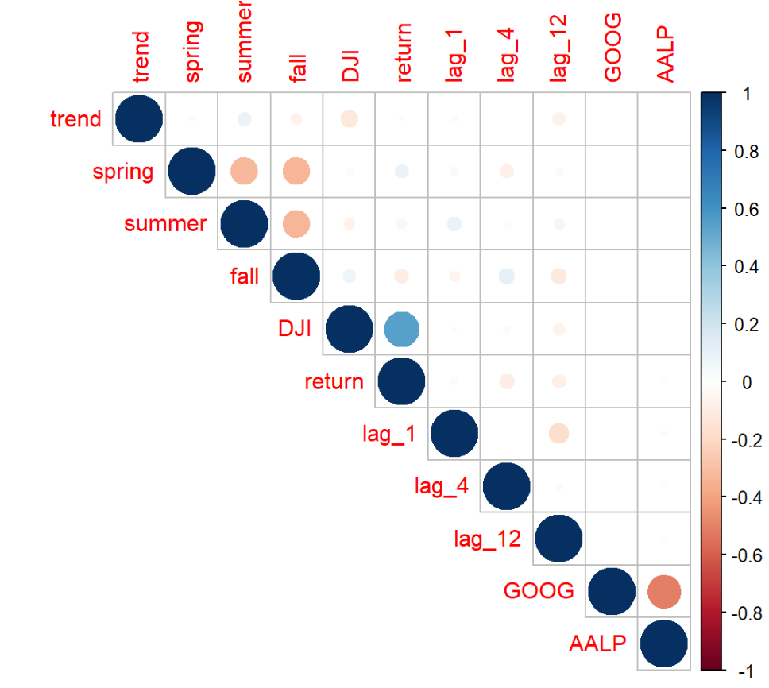
Summary Statistics- Correlation Matrix
From the correlation plot, we learned that the Dow Jones Industrial has a positive correlation with the three companies' returns seen by the dark blue cross-point. Returns in Summer and Spring are positive, but their relationship is not as strong as the previous one, and their cross-point is light blue.

Slide 12
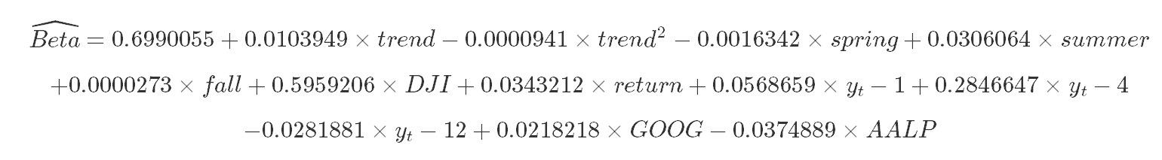
Model Selection
We will be using the backward propagation approach where we will drop columns that have a high p-value and then observe the resulting R2 in the next iteration to ensure there is an improvement
In the first model, we used all variables and additional trend square to build a full model a predict the value of beta.
The AR model is the most common model used in value prediction, it depends on the previous values and creates a linear model.

Slide 13
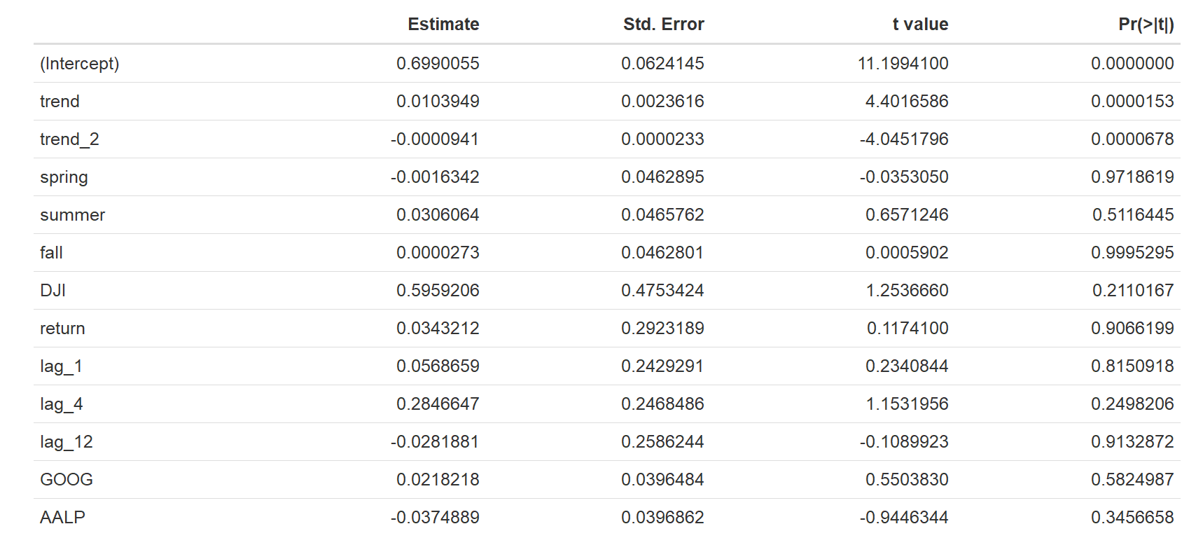
Model Selection-Approach
We will download the data for a 10-year window and add trend and seasonal variables to check if change in volatility is affected by seasonality
We will add dummy variables to the model before we forecast and compute R2 ,MSE and MAE scores. There will be two dummy variables representing the returns of the two companies where the third will be the base value . Since the scatterplot for the beta shows a parabola, we will add a quadratic term as well

Slide 14
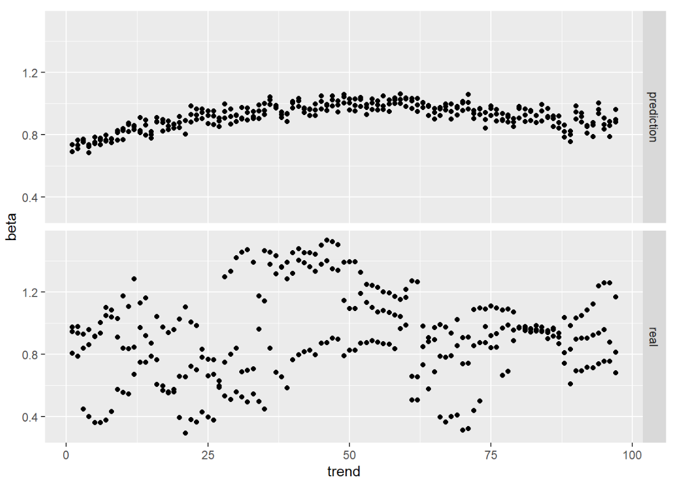
Feature values and prediction for first model
MSE:0.0472362
MAE:0.217339
Adjusted R2:4.41%
Based on the result of model 1, we choose to drop variables with a high p-value, such as spring, summer, fall, one year lagged variable

Slide 15
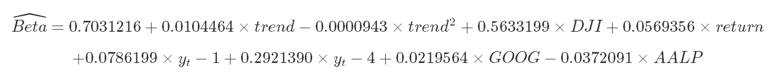
Feature values and prediction for second model
MSE:0.0494296
MAE:0.2223277
Adjusted R2: 5.53%
From the p-value result of model 2 we will drop variables with a high p-value, companies return, company dummy variable, one month lagged variables, and then observe the R-square of the next model.

Slide 16
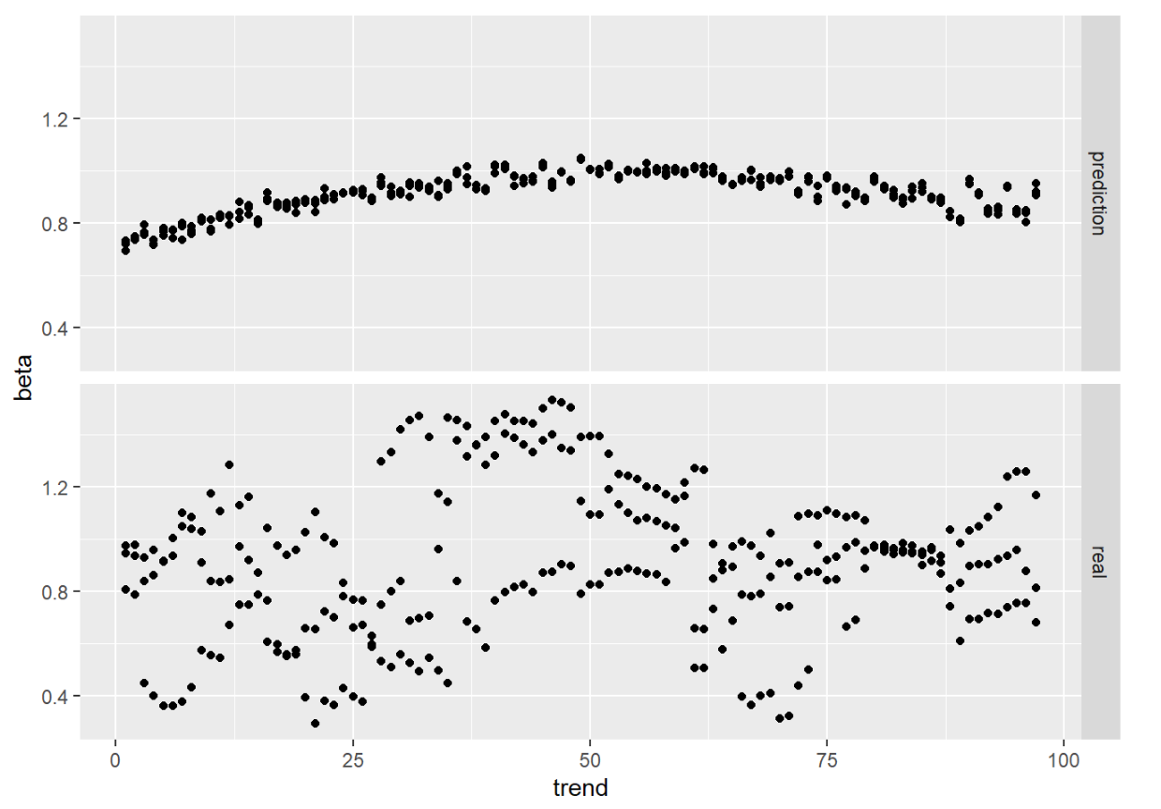
Feature values and prediction for third model
MSE:0.0511617
MAE:0.2261896
Adjusted R2: 6.04%

Slide 17
Final Model
Assumptions:
1: E(ϵ|xi)=0E(ϵ|xi)=0
2: ϵϵ ~ N[0,ϵ2]N[0,ϵ2]
3: ϵϵ are independent variables
Estimated Regression Line
Interpretation of the slope
As each month passes, beta is expected to increase 0.0000694, regardless of the beta in the same month of the previous four months.
Interpretation of the slope for DJI
The beta is expected to increase 0.1169623 on average, holding the effect of time fixed.
Interpretation the slope of seasonal variable
The beta is expected to increase 0.2296484 on average, holding the effect of time and market return fixed.
Interpret the intercept
At time = 0 and market return = 0 and beta in the same month of the previous 4 months = 0, the beta is expected to be 0 on average.
Interpret R2
The R-squared of model 3 is 0.07336, adjusted R-squared of model 3 is 0.0604. The adjusted R-squared in model 1 is 0.0441, the adjusted R-squared in model 2 is 0.05537, compared with the two models, model 3 is the better one. Even though model 3 is the best one, the R-square of model 3 is still small enough, and we need to add more features to improve the model performance.

Slide 18
Hypothesis Testing(Does the beta change have a seasonal pattern)
Step 1:
H0:β4=0
Ha: β4≠0
Step 2:
Find the p-value for this coefficient, 0.2296484
Step 3:
Reject the null when p-value < 5%
Step 4:
Since p-value = 22.96% > 5%. We can't reject the null. We can't prove that the beta has a seasonal pattern.

Slide 19
Conclusion
To sum up, in this project our goal is to predict the beta value based on the time series model. We used seasonal variables including 4 season and lagged variables, we also used the linear trend variable and its quadratic term, we separated the stock return for the three companies .The first model is the full model after we analyze the result. We constructed the second model, dropped some variables that have a large p-value, and the third model building also follows the same method. Thus, by evaluating the adjusted R-square and p-value we used the backward elimination method to organize our project, and this method can provide good guidance for our project development.
Findings
The interesting finding is that the adjusted R-square of the three models is very small, all of them lower than 0.1, thus, all of these three models have not fully explained the economic phenomenon. In order to get a better prediction in the future, we need to add more features to our model.
From the p-value perspective to analyze the result, we only found that two variables can provide better influence on the model prediction, trend, and its quadratic pattern.

Slide 20
Conclusion-Quality of Data
The different industries may have different effects on model performance. In this project, we selected three companies all of which are technology companies, and we choose the market return from the Dow Jones Industrial. To improve the reliability, we can select the stock return from companies from other domains and keep adding more companies till we get a generalized equation
Future Scope
Since the nature of each industry vary from one to another, we propose to collect more features and build the model industry by industry.
We plan on making a much more robust model by adding returns of other companies from myriad domains and get a holistic idea of which features explain the variation in beta most

Slide 21
THANK YOU

